Slide 1
National and Regional IGF Initiatives (NRIs)
- IGF 2016 Status update as an input to the IGF 2017 Open Consultations and MAG Meeting -
IGF Secretariat, NRIs Focal Point, March 2017

Slide 2
Origin and background of the NRIs
The Tunis Agenda established the Internet Governance Forum (Para 72)
No specific call for national or regional IGFs
Recognition that multistakeholder approach is a fundamental principle
Encouraging development of multistakeholder processes at national, regional and international level to discuss and collaborate … (Para 80)
Some countries began holding sessions and meetings as early as 2006, but formal recognition by the IGF Secretariat grew from then to 2009, when many countries were begining to formalize national and regional level initiatives

Slide 3
IGF NRIs
NRIs agree to follow the core principles and characteristics of the IGF itself, in order to be identified with the IGF and to be listed on the IGF website. In addition, the NRIs coordinators have developed basic requirements including an annual report to the Secretariat, available on the IGF webiste.
Core characteristics and principles:
Organic
Independent
Stakeholders act on equal footing (just as at the IGF itself)
Bottom up
Multistakeholder
Open and Transparent
Inclusive
Non commercial

Slide 4
NRIs – continued evolutionary growth
2011 (37)
2015 (37)
2016 (72 + 7 ‘in-formations’)

Slide 5
IGF 2017: Total number of recognized and ‘in-formation’ NRIs is 91

Slide 6
NRIs 2016 annual events overview
First IGF Open Consultations and MAG Meeting
Second IGF Open Consultations and MAG Meeting
IGF 2016 Annual Meeting
2016
2016
Jan
Feb
Mar
Apr
May
Jun
Jul
Aug
Sep
Oct
Nov
Dec
2016
Today
Central Asia IGF
Germany IGF
SEEDIG
Benin IGF
Georgia IGF
Portugal IGF
Finland IGF
EuroDig
Ghana IGF
West Africa IGF
UK IGF
Sri Lanka IGF
Russia IGF
Croatia IGF
Kenya IGF
Bosnia and Herzegovina IGF
Nigeria IGF
Caribbean IGF
Belarus IGF
AP IGF
Africa IGF
Uruguay IGF
LACIGF
South Africa IGF
Slovenia IGF
Youth LACIGF IGF
Ukraine IGF
Netherlands IGF
Chad IGF
Austria IGF
Youth AP IGF
Youth German IGF
Poland IGF
Armenia IGF
USA IGF
Paraguay IGF
Brazil IGF
Colombia IGF
Events as announced by the NRIs Coordinators to the IGF Secretariat.

Slide 7
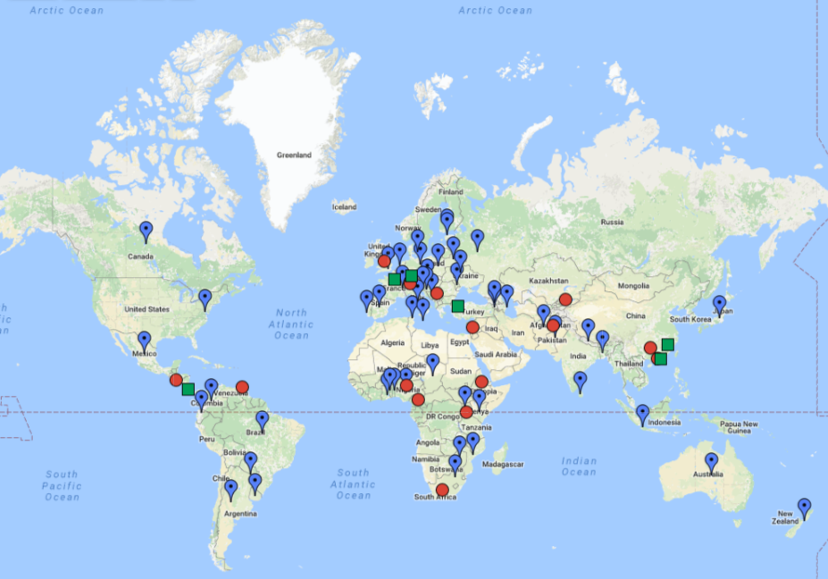
NRI Geographic Coverage – from a Global View
* This Map is constantly being updated as new Initiatives are emerging.

Slide 8
NRIs activities during the IGF 2016 cycle
79 NRIs (72 officially recognized and 9 ‘in-formation’) collaborate through out the year, in order to organize the following activities for the annual 2016 IGF meeting:
NRIs Main Session
17 virtual meetings organized, several public surveys to receive inputs in a bottom up manner, for organizing the main session. 42 NRIs presented on behalf of their respective communities on the following topics:
Access and Enhancing Opportunity for the Un-Connected and Under-Connected;
Secure, Resilient and Trusted Internet from the NRI Perspectives;
Reliable and sustainable funding sources for the NRIs events ;
Challenges in how to create more awareness about Internet Governance and why stakeholders should be actively engaging.
NRIs Coordination Session
An open meeting with the IGF MAG Chair, IGF Secretariat and UNDESA on the nature of the IGF’s collaboration with the NRIs and the NRIs biggest challenges
NRIs Info-Booth
Developed informational material and the NRIs schedule of face to face consultations during the meeting days with interested stakeholders.

Slide 9
IGF NRIs Toolkit to assist communities in establishing the IGF initiatives
The IGF Secretariat in collaborating with the NRIs Working Group and the NRIs have developed a publication that explains the nature of their organization.
It describes the basic requirements for an IGF initiative to be listed on the IGF website.
It also offers suggestions about organizing structures.
The Toolkit stands as an advisory document and is a result of the NRIs collaborative process on establishing basic requirements such as adhering to the IGF principles.
It is available at the IGF website.

Slide 10
2017 NRIs work in process
‘NRIs in practice’ Publication
The NRIs and the IGF Secretariat are developing an extensive publication that will look at the best practices of the NRIs in regards to their:
Internal multistakeholder organizational structure;
Implementation of the IGF principles in practice;
Models for gathering inputs from communities to develop a programme for the NRIs annual meetings;
Ways of reporting toward the wider IGF community, and
Biggest challenges they are facing while working.
Youth Initiatives to the IGF
The Secretariat facilitates the process of the NRIs developing standards for establishing and running the substantive tracks dedicated to Young people in communities where there is identified need for it.

Slide 11
Contributing to the NRIs
Engaging with the NRIs is based on inclusion and engagement at the national, sub-regional and regional levels.
All NRIs are encouraged to maintain an open door to their outreach and engagement with their relevant stakeholders. The annual required reports are also excellent resources to learn more about any particular NRI’s activities.
In addition, the IGF Secretariat maintains a dedicated email list for those who want to support the work of the NRIs or attend their working calls. Meeting reports are provided for all of the working calls and available in the NRIs archive – thus open to the interested public.
For any NRIs related questions, contact the IGF Secretariat at: igf@unog.ch where a dedicated Focal Point to the NRIs will assist further.

