Slide 1
EIGHT CHALLENGES FOR INTERNET GOVERNANCE
David Souter
IGF, November 2021

Slide 2
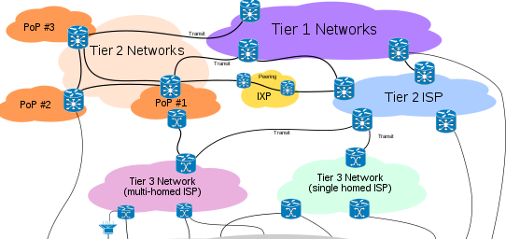
WHAT IS THE INTERNET?
IS IT … ?
OR IS IT … ?

Slide 3
“NARROW” VERSUS “BROAD” Internet governance
Governance of the internet itself
Governance that concerns the impact of the internet

Slide 4
THE WSIS “working DEFINITION”, 2004/2005
“Internet governance is the development and application by Governments, the private sector and civil society, in their respective roles, of shared principles, norms, rules, decision-making procedures, and programmes that shape the evolution and use of the Internet.”

Slide 5
what did wsis seek? (“BROAD ig”)
“a people-centred, inclusive and development-oriented Information Society, where everyone can create, access, utilize and share information and knowledge, enabling individuals, communities and peoples to achieve their full potential in promoting their sustainable development and improving their quality of life, premised on the purposes and principles of the Charter of the United Nations and respecting fully and upholding the Universal Declaration of Human Rights.”

Slide 6
THE EVOLUTION OF THE INTERNET
Geeks and scholars
Industrial countries
Global
market
Global mass market
Commercialisation
Web 2.0 &
social media
Mobility
ftp, usenet & other protocols
World
Wide Web
Cloud computing
Internet of Things

Slide 7
Three critical changes in the ecosystem of the internet
The growing importance of the internet in economy, society and culture
Proliferation in the number and scope of decision-making bodies
Commercialisation and the concentration of economic power

Slide 8
focus areas for 1gf 2021
Emerging regulation
Environmental sustainability and climate change
Universal access and meaningful connectivity
Economic and social inclusion and human rights
Inclusive internet governance
Trust, security and stability

Slide 9
Eight challenges for internet/digital governance
The pace of change and changing nature of the internet: scale and technology
The internet as part of digitalisation
The concentration of digital power
Digital geopolitics (and the environment)
Shaping the digital future: opportunities and risks
The future of regulation (permissionless innovation and the precautionary principle)
Multilateralism and multistakeholderism
Participation in decision-making

Slide 10
The pace and changing nature of the internet: scale and technology
Geeks and scholars
Industrial countries
Global
market
Global mass market
Commercialisation
Web 2.0 &
social media
Mobility
ftp, usenet & other protocols
World
Wide Web
Cloud computing
Internet of Things

Slide 11
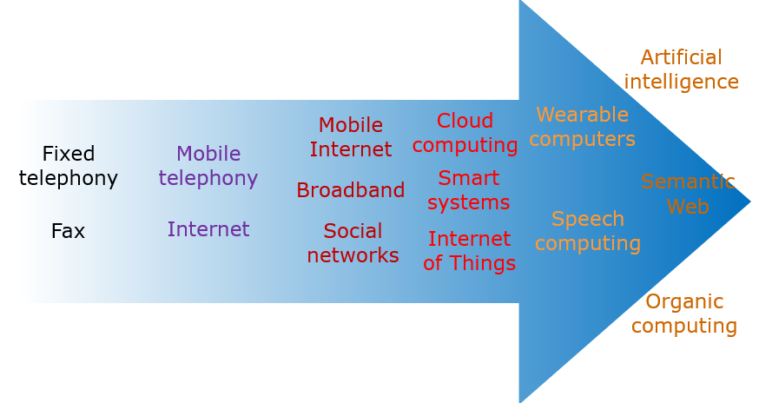
The internet as part of digitalisation

Slide 12
THE CONCENTRATION OF DIGITAL POWER

Slide 13
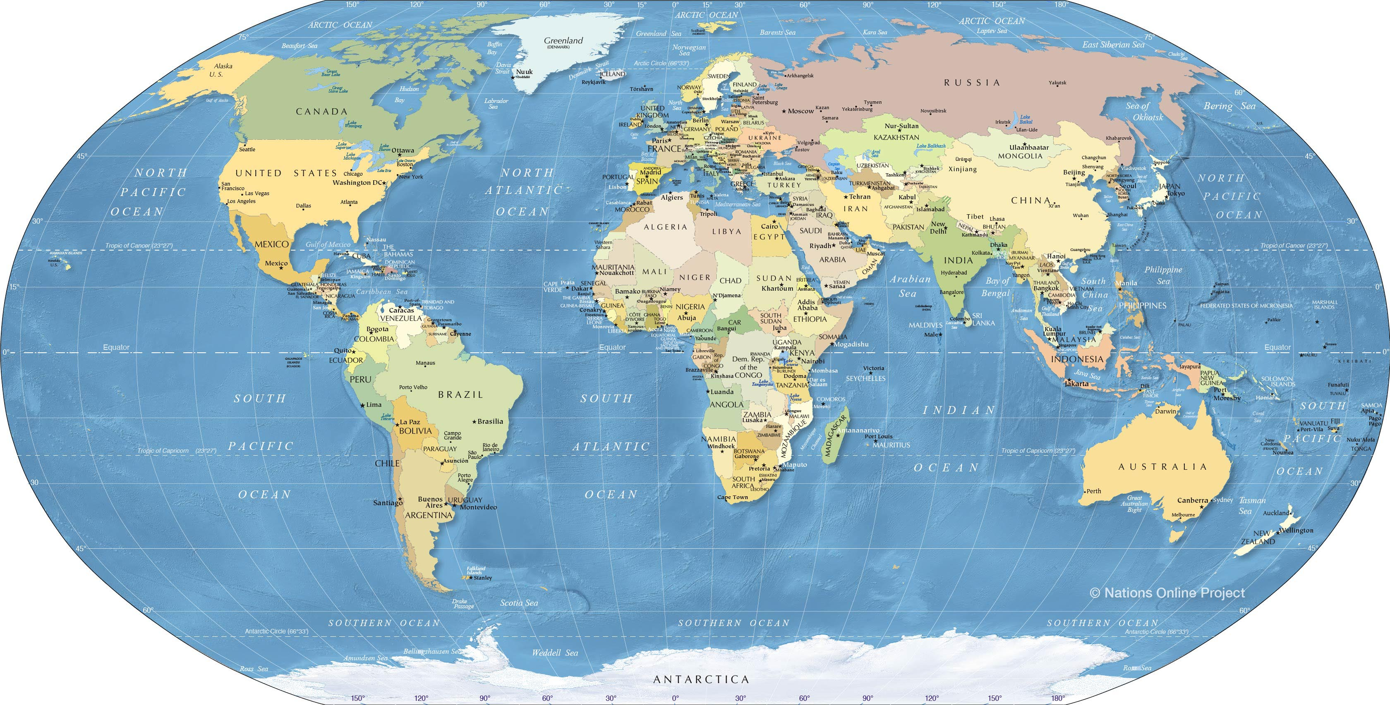
DIGITAL GEOPOLITICS (and the environment)

Slide 14
Shaping the digital future
Preserving what we value
Promoting what we want
Preventing what we fear

Slide 15
The future of regulation
Permissionless innovation
Versus
The precautionary principle

Slide 16
Multilateralism and multistakeholderism

Slide 17
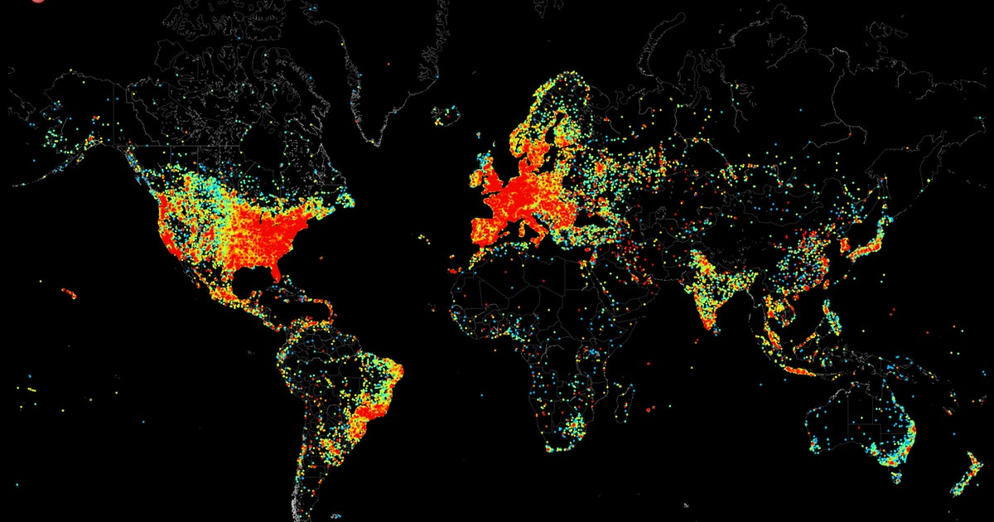
Participation in decision-making

Slide 18
Shaping the digital future
Preserving what we value
Promoting what we want
Preventing what we fear

