Slide 1
Internet Governance Forum
JAPAN
Kyoto
October8-12,
2023

Slide 2
Japan host IGF 2023 for…
As digitalization goes on, the Internet has become a truly fundamental infrastructure for whole range of economic and social activities, and accessibility to the network is a part of basic human rights. Now is the time to realize global and inclusive Internet for everyone.
Over the past years, the world experienced global challenges including, COVID-19 pandemic and Russia's invasion of Ukraine.
These events reminded us of the importance of open, free, global (or unfragmented) and resilient Internet, as well as the discussion in the "multi-stakeholder approach" .
Japan firmly believe inclusivity and diversity of the Internet is the core source of innovation and presents the fundamental value of the Internet as social foundation.

Slide 3
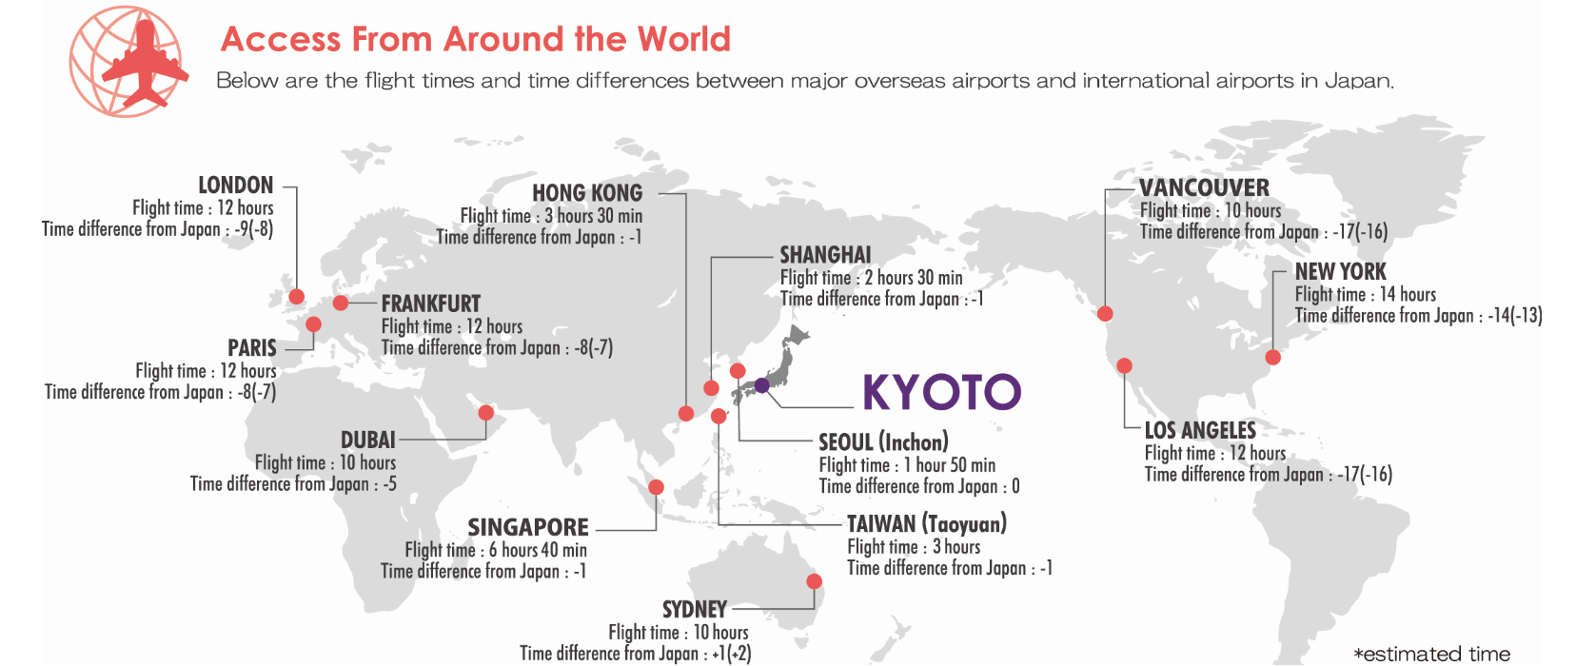
Where is Kyoto ?
Kansai International Airport
The closest international gateway to Kyoto is Kansai International Airport, which is serviced by 79 airlines and serves as the international and domestic hub for the Kansai region of Japan.
Access to Kyoto from Kansai International Airport
There are multiple options for transportation to Kyoto from Kansai International Airport, allowing visitors to choose a method to fit their schedule and budget. As Kyoto is a popular destination, transportation information at the airport is readily available and easy to understand.
Method | Time | Cost | Main Dropoff Location | Notes
Express train | Approx. 75 minutes | 2900 – 3500JPY (approx. 26-31 USD) | Kyoto Station | Exact fare varies depending on season and seat type
Highway bus | Approx. 95 minutes | 2600 JPY (approx. 23 USD) | Kyoto Station
Shuttle taxi | Approx. 95 minutes | 4,300 - 5000JPY (approx. 38-44 USD) | Direct to accommodation | Ride-share service provided by taxi companies

Slide 4
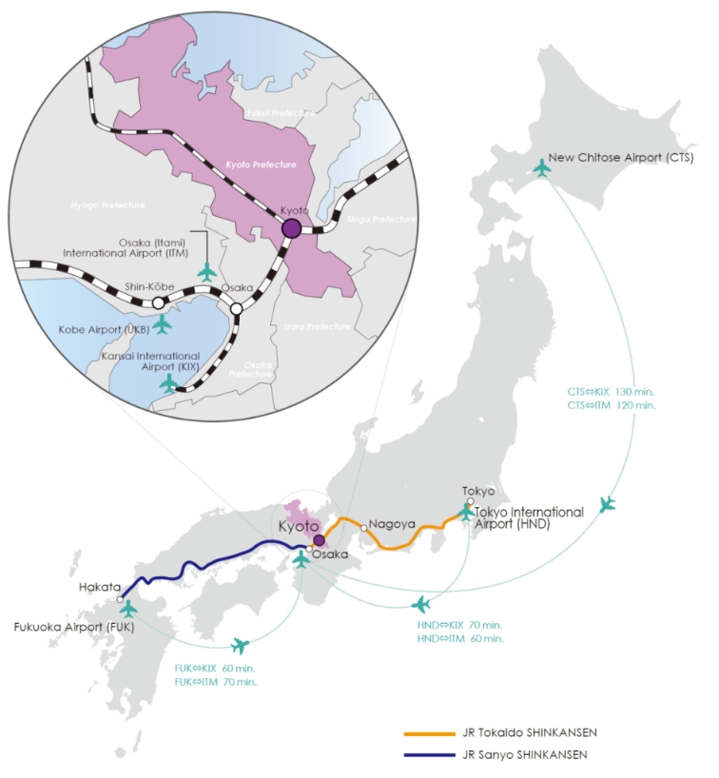
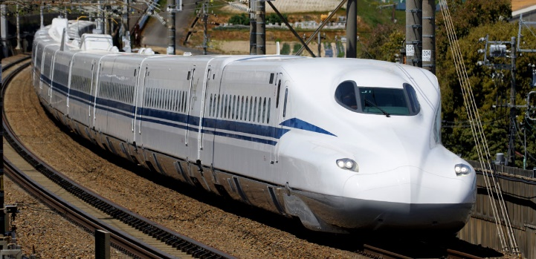

Where is Kyoto ?
Easy Transfer from Additional International Gateways
As a major city in Japan, Kyoto is also easily accessed via domestic transportation, which means visitors can land at another international gateway and even have opportunities to explore more of the country before or after arriving at Kyoto.
Via domestic flights
Osaka International Airport, more commonly known as Itami Airport, is a domestic airport that connects to most major international airports in Japan and is located closer to Kyoto than Kansai International Airport
Narita International Airport (NRT)
Approx. 80 min.
Tokyo (Haneda) International Airport (HND)
Approx. 60 min.
Fukuoka Airport (FUK)
Approx. 70 min.
New Chitose Airport (CTS)
Approx. 120 min.
Osaka International (Itami) Airport (ITM)
Approx. 50 min. by highway bus
Approx. 70 min. by train
Kyoto
Via shinkansen bullet train
Kyoto is serviced by Japan’s famous shinkansen bullet train, which offers a scenic and speedy way to travel between cities.
From Tokyo: approx. 2 hours 15 min.
From Kobe: approx. 30 min.
From Fukuoka: approx. 3 hours
From Hiroshima: approx. 1 hour 40 min.

Slide 5
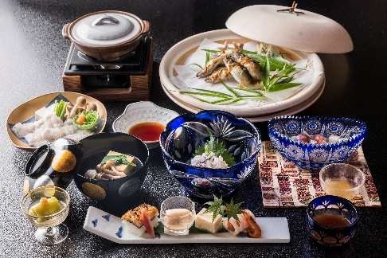
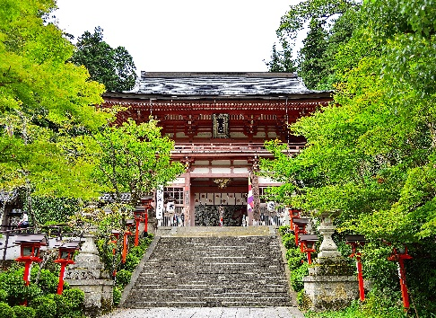
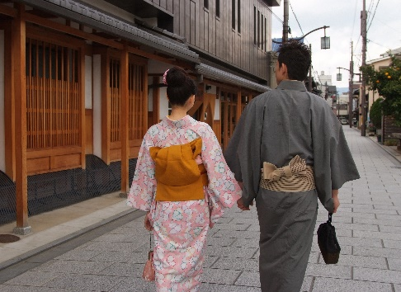
Facts About Kyoto
One of Japan’s most famous cities, Kyoto has over 1,200 years of history and was the capital of Japan until the late 1800s, making it the nucleus of traditional Japanese arts and culture even now.
A compact city nestled in a valley surrounded by mountains, Kyoto is built in a grid pattern that makes for easy navigation using public transportation, bicycling, or walking.
Visitors can taste authentic Japanese cuisine, visit World Heritage Sites and a myriad of museums, and enjoy cultural experiences such as tea ceremony, sake brewery tours, wearing kimonos, and more.
A popular destination for both domestic and overseas travelers, Kyoto welcomes each guest with its famed omotenashi hospitality.

Slide 6
Facts About Kyoto
Current population:
1.46 million (9th largest city in Japan including Tokyo)
Average temperature in October :
（high）22.6°C (low) 12.0℃
Average rainfall in October : 126.7 mm
Time zone: Japan Standard Time (GMT +9)
City center:
Approx. 10 km (6 miles) north-south, 8 km(5miles)east-west
Geography:
Basin surrounded by low mountains to the west, north & east;
gently sloping down from north to south; bisected by rivers
Major universities:
Kyoto University, Ritsumeikan University, Doshisha University,
Kyoto Prefectural University
Major businesses and corporations:
Nintendo, Kyocera, Omron, Rohm, Shimadzu, Horiba, Wacoal

Slide 7
Kyoto Information
Accommodation
There are over 57,000 rooms in almost 4,000 facilities in Kyoto, ranging from luxury resorts and international hotel brands to budget-friendly hostels and guest houses. Guests also have the option of staying in traditional Japanese inns, called ryokan.
Many hotels are located on along the Kyoto City Subway routes, offering simple and convenient access from the conference center.
Public Transportation
With the City of Kyoto committed to making Kyoto a walkable city, there is an extensive public transportation network including subway, buses, and trains, which accept payment via IC card in addition to cash. Various types of discount passes are also available.

Slide 8
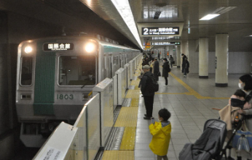
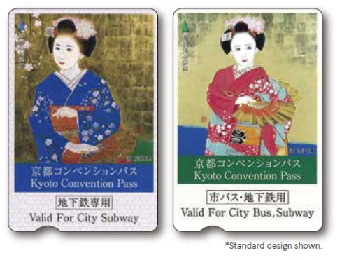
Kyoto Information
Subway The Kyoto City Subway has only 2 subway lines that run from north to south and east to west, making navigation simple. Station signs are marked in English, Chinese, Korean, and Japanese.
Bus The municipal bus system covers the entire city and offers sightseeing routes and English announcements for major stops. A flat-fare zone covers most of the city, at 230 yen per ride and a discount for bus transfers made within 90 minutes.
Trains In addition to JR West Japan, the city is serviced by the following railways: Keihan Railway, Hankyu Railway, Kintetsu Railway, Randen (Keifuku Railway), Eizan Railway, Sagano Scenic Railway.
Convention Pass
Organizers of international conferences can provide participants with the Kyoto Convention Pass, which offers greater savings than the standard discount passes for travel on the Kyoto City subway and buses, making it easy for participants to travel to the venue, hotel, and sightseeing spots in an eco-friendly way.

Slide 9


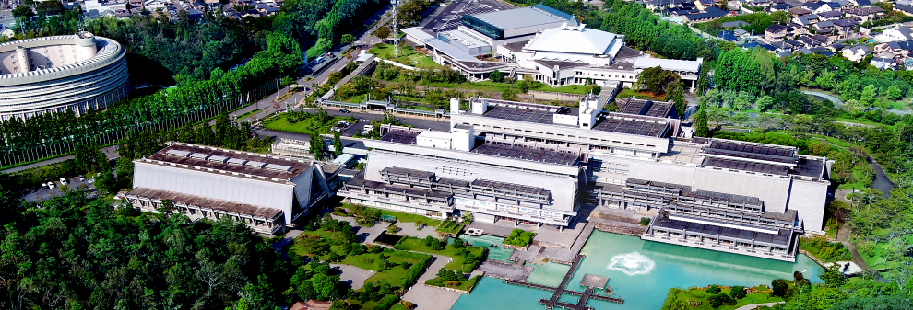
Conference venue ICC Kyoto
・Located amidst the nature of Kyoto, the cultural heart of Japan
・Easily accessible by subway from major hotels and popular tourist spots
・The closest hotel conveniently located across the road, and there are variety of accommodations available around.
3-min. walk
New Hall
Exclusive road
Event Hall
Subway Exit
Main Building
Annex Hall

Slide 10
Preparation
➢ MIC has set up a special team with designated members.
➢ National multi-stakeholders community has been revitalized for preparatory activities. (with a name of Japan IGF Taskforce)
➢ Professional Congress Organizer will be selected soon.
➢ IGF2023 logo will be also soon designed.
➢ All information will be available on the Host Country
Website in June (including accommodation, transport, visa
etc……)

Slide 11
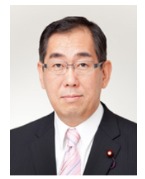
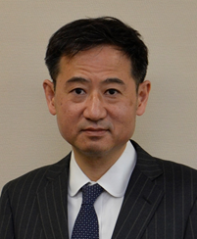
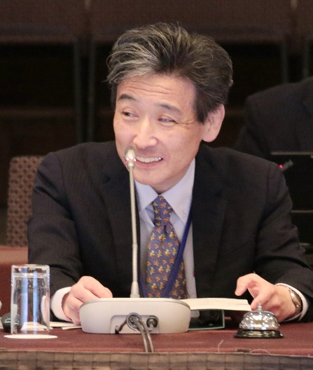
IGF2023 Preparatory Team Leadership
Mr. Takeaki Matsumoto
Minister for Internal Affairs and Communications
Mr. Hiroshi Yoshida
Vice-Minister for Policy Coordination,
Ministry of Internal Affairs and Communications, Japan
IGF Leadership Panel
2023 Host Country Representative
Mr. Yoichi Iida
Deputy Director General for G7 and G20 relations at the Ministry of Internal Affairs and Communications, Japan.
MAG co-chair.

Slide 12
Theme for IGF2023
Japan suggest theme for IGF2023
①Global Internet for everyone
②Internet for everyone –
a critical infrastructure for democracy
③Better internet for the planet
- Internet way of ethics, peace and civilization
④Trustworthy Internet for the future
⑤Empowering multi-stakeholders
for the future of the Internet

