Slide 1

IGF 2018
First IGF Open Consultations and MAG Meeting
- Update to the MAG Orientation Session on the NRIs -
19-22 March 2018 IGF Secretariat
Geneva, Switzerland

Slide 2
Origin and Background of the NRIs
The Tunis Agenda established the Internet Governance Forum (Paragraph 72)
No specific call for national or regional IGFs
Multistakeholder approach recognized as a fundamental principle
Encouraged development of multistakeholder processes at national, regional and international level to discuss and collaborate … (Paragrah 80)
Some countries and regions began holding sessions and meetings as early as 2006, but formal recognition by the IGF Secretariat grew from then to 2009, when many countries were begining to formalize national and regional level initiatives.

Slide 3
NRIs – continued evolutionary growth

Slide 4
IGF 2018: Total number of recognized and ‘in-formation’ NRIs is 107

Slide 5
Jan.
Trinidad and Tobago IGF, 26 January
March
Afghani-
stan IGF, 29-30 March
April
Russia IGF, 7 April
May
Belarus IGF, 16 May
June
EuroDIG, 6-7 June Estonia
July
Sep.
Oct.
Nov.
Dec
Central Africa IGF, 10-11 April, Republic of the Congo
Panama IGF, 25 April
Finland IGF, 26 April
Croatia IGF, 16 May
Sri Lanka IGF, 16-18 May
Pacific IGF, Vanuatu 17-18 May
Senegal IGF, 18 May
SEEDIG, 24-25 May, FYR Macedonia
Swiss IGF, 30 May
Peru IGF, 6-7 June
Barbados IGF, 22-23 June
Central Asia IGF, 22-23 June Tajikistan
Cameroon IGF, 28-29 June
Aug.
Kenya IGF, 6 July
Nigeria IGF, 13 July
Benin IGF, 22 July
IGF-USA,
24 July
Asia Pacific IGF, 26-29 July, Thailand
Guatemala IGF, 27 July
West Africa IGF, 27-28 July
LACIGF,
2-4 Aug., Panama
Malawi IGF, 8 Sep.
Georgia IGF, 12 Sep.
UK-IGF, 13 Sep.
Namibia IGF, 27-28 Sep.
Portugal IGF, 29 Sep.
Armenia IGF, 2 Oct.
Colombia IGF, 4 Oct.
Dominican Republic IGF, 5 Oct.
Netherlands IGF, 10 Oct.
Austria IGF, 16 Oct.
Tunisia IGF, 17 Oct.
Slovenia IGF, 17 Oct.
Uganda IGF, 27 Oct.
Brazil IGF, 14-17 Nov.
German Youth IGF, 14 Nov.
Mauritius IGF, 16 Nov.
Ecuador IGF, 24 Nov.
Netherlands Youth IGF, 5 Oct.
Spain IGF, 28-29 Nov.
Nepal IGF, 18’19 Aug.
Caribbean IGF, 22-23 Aug.,
British Virgin Islands
Costa Rica IGF, 31 Aug.
Uruguay IGF, 13 Sep.
Uruguay Youth IGF, 15 Sep.
Ukraine IGF, 6 Oct.
Indonesia IGF, 28 Oct.
German IGF, 15 Nov.
Argentina IGF, 16-17 Nov.
Bolivia IGF, 16-17 Nov.
Italy IGF, 20-21 Nov.
Poland IGF, 21 Nov.
Turkey Youth IGF, 26 Nov.
Chad IGF, 27 Nov.
FYR Macedonia IGF, 28 Nov.
South Africa IGF, 28-29 Nov.
Paraguay IGF, 29-30 Nov.
African IGF,
4-6 Dec., Egypt
Youth Africa IGF, 4-6 Dec., Egypt
Zimbabwe IGF,
11 Dec.
Bosnia and Herzegovina IGF, 12 Dec.
Youth LACIGF,
1 Aug., Panama
North Africa IGF, 2-3 Dec., Egypt
Uganda IGF, 14 Dec.
DR Congo IGF, 12-13 Dec.
NRIs 2017 meetings
Legend: National IGFs | Regional IGFs | Youth IGFs

Slide 6
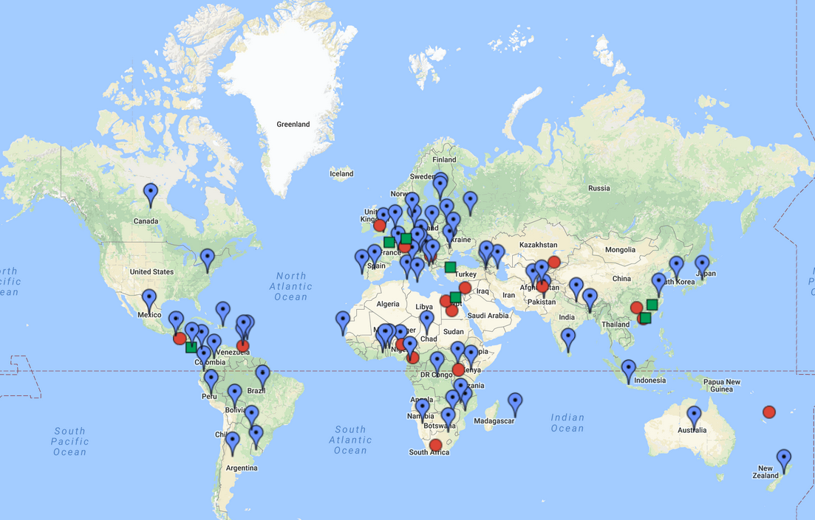

NRIs Geographical Coverage

Slide 7

Integration of the NRIs at the IGF 2017
Eight NRIs Collaborative Sessions
More than 30 different IGFs partnered on topics of mutual interest: access, IPv6, fake news, blockchain technologies, data, IG for sustainable development, securing critical information infrastructure in Europe, IDNs
NRIs Main Session
NRIs Perspectives: Rights in the Digital World
NRIs Info Booth at the IGF Village
NRIs Coordination Session
Open work meeting between the NRIs, UNDESA, MAG Chair and IGF
Secretariat
Open Work Meeting between the Youth IGF Initiatives and the IGF Secretariat

Slide 8
Contact the IGF Secretariat:
igf@un.org
Subscribe to the NRIs mailing list:
igfregionals@intgovforum.org
شكرا 谢谢 Thank You Merci Спасибо Gracias

