Slide 1
Internet Governance Forum 2022 Expanding the possibilities for Internet access through innovation: experience sharing from Uganda
Notes:
Good morning all, my name is Suzane Muhereza and I’m a Monitoring, Evaluation and Learning Manager with the Internet Society Foundation.
Pleased to be here with you today to facilitate this lightning talk, which will explore the role of innovation in expanding possibilities for Internet access, and take a specific look at some very interesting work underway in Uganda
With me today is Brian Masiga. Brian is a Network Engineer at the Research and Education Network for Uganda, also known as RENU.
Since 2021, the Internet Society Foundation has supported RENU’s work to expand Internet access for the research and education community in Uganda, and you’ll hear more about how they’re doing this in just a few minutes.
But first, a quick overview of our organization.

Slide 2
Vision:
The Internet is
for Everyone.
Notes:
Established in 2019, The Internet Society Foundation exists to support the positive difference the Internet can make to people everywhere.
It promotes the development of the Internet as a global technical infrastructure, a resource to enrich people's lives, and a force for good in society.
Our vision is – An Internet for Everyone

Slide 3
Mission: The Internet Society Foundation champions ideas and enables communities to unlock the Internet's potential to tackle the world’s evolving challenges.
Notes:
And our mission is: to champion ideas and enables communities to unlock the Internet's potential to tackle the world’s evolving challenges.

Slide 4
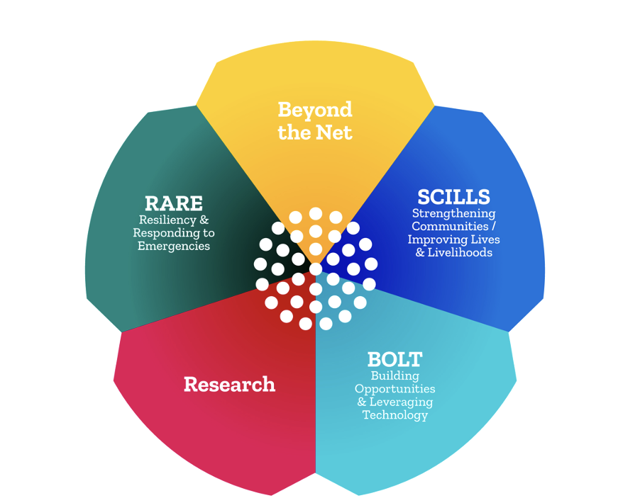
Funding Areas Overview
The Foundation also provides funding to the Global, Regional & National Internet Governance Forums (IGFs) as well as Schools of Internet Governance. Additionally, the IETF LLC receives funding each year from the Foundation.
Notes:
Our portfolio currently has five funding areas – as you see here, and the one we’ll focus on today is our BOLT Program. But you can find out more about all of these programs on our website at isocfoundation.org

Slide 5
Building Opportunities/Leveraging Technology (BOLT)
Seeks to empower teams of innovators to develop solutions to Internet connectivity
Program launched in 2021
Opened for second round of applications in Aug 2022
Program aims to:
Improve Internet access and connectivity globally
Promote responsible innovation
Notes:
The focus of this lightning talk is “innovation around the Internet”, and that is exactly what our BOLT program was designed to do.
The program launched in 2021, and it aims to empower teams of innovators around the world to develop solutions to Internet connectivity.
And one of these innovators is here with us today. Together with his team at RENU, Brian is working to extend internet access for the research and education community in Uganda.
And I’ve prepared 5 “lightning questions” to ask Brian, to shed some light on the work RENU is doing, and delve into how it’s supporting responsible and sustainable innovation around the Internet.
A little about Brian:
- Network Engineer at the Research and Education Network for Uganda.
- Volunteer Network Engineer at the Uganda Internet eXchange Point.
- Zealous about internet development and how it impacts the lives of people

Slide 6
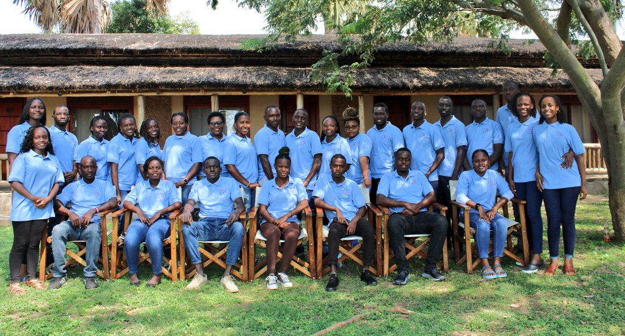
Research and Education Network of Uganda (RENU)
Established in 2006
Aims to facilitate collaboration among Uganda's research and education institutions for knowledge creation, sharing and use
Cooperatively owned and community-driven service provider

Slide 7
Five questions with Brian…
How would you describe the mission of your organization, the Research and Education Network for Uganda (RENU)?
Last year, RENU received a $200,000 grant from the Internet Society Foundation to extend access to Metro eduroam, a free global Wi-Fi roaming service for the research and education community.
Tell us about Metro eduroam. How does it work, and what problem is it solving?
Can you share a few examples of how target communities are positively benefiting from Metro eduroam?
In your view, what makes this project an example of responsible innovation around the Internet?
What would you say is the most important lesson you’ve learned in implementing this project?

Slide 8
Visit isocfoundation.org to learn more about our work

