Slide 1
IGF – Launch of DC-ISSS
6 November 2020
Ghislain de Salins – Policy Analyst, Digital Economy, OECD.

Slide 2

What is the OECD?
The OECD is an international organisation focusing on economic and social prosperity
Multilateral:
  37 member countries and collaboration with more than 100 countries
  Contributes substantially to G7 and G20
  Primary target audience is government policy makers
Multi-stakeholder: businesses; civil society and the technical community participate in OECD work, through advisory committees and expert groups.
Within OECD, the working party on Security in the Digital Economy (SDE) is responsible for analysis and co-operation
on digital security policy.

Slide 3
Digital security of products and IoT is increasingly an area of focus for policy makers
  In recent years, policy makers have identified the digital security of products, and IoT in particular, as a key issue:
  Global Commission on the Stability of Cyberspace (GCSC) : “Developers and producers of products and services on which the stability of cyberspace depends should prioritize security and stability” (2018) ;
  Paris call for security and trust in cyberspace : “we affirm our willingness to work together, notably in order to […] strengthen the security of digital processes, products and services, throughout their lifecycle and supply chain” (2018) ;
  G7 Foreign Affairs Ministers Communiqué: “[We] encourage initiatives that strengthen the security and resilience of digital infrastructure, products and services (2019, France) ;
  G20 Ministerial Statement on Trade and Digital Economy: “We recognize the importance for governments and other stakeholders within their respective roles to address security gaps and vulnerabilities” (2019, Japan) ;
  UN Secretary-General’s High-level Panel on Digital Cooperation : “[We] should seek to improve transparency and quality in the development of software, components and devices” (2019).
  Cyberspace Solarium Commission: “We are dangerously insecure in cyber [and] the status quo is not getting the job done” (2020, USA).

Slide 4
Work stream on the digital security of products
Feb 2020
Scoping paper discussed at SDE
Nov 2019
First multi-stakeholder international expert group workshop
June 2020
First draft of the analytical report, discussed by SDE
Nov 2020
Two reports to be finalized and declassified by SDE: one analytical report and one policy-oriented report.
July
2020
Second multi-stakeholder international expert group workshop
Written input from the expert group
Written input from the expert group
Jan 2020
Publication

Slide 5
A holistic approach is key for IoT security
Value chain
Manufacturer
Suppliers
Code owners
Service providers
Vendor
Ecosystem
IoT device
Cloud infrastructure
Applications
Lifecycle
Design & development
Commercial life
End-of-Life
Risk-based approach
Context of use
Likelihood of attacks
Potential impact
Security by design
Potential digital security gaps

Slide 6
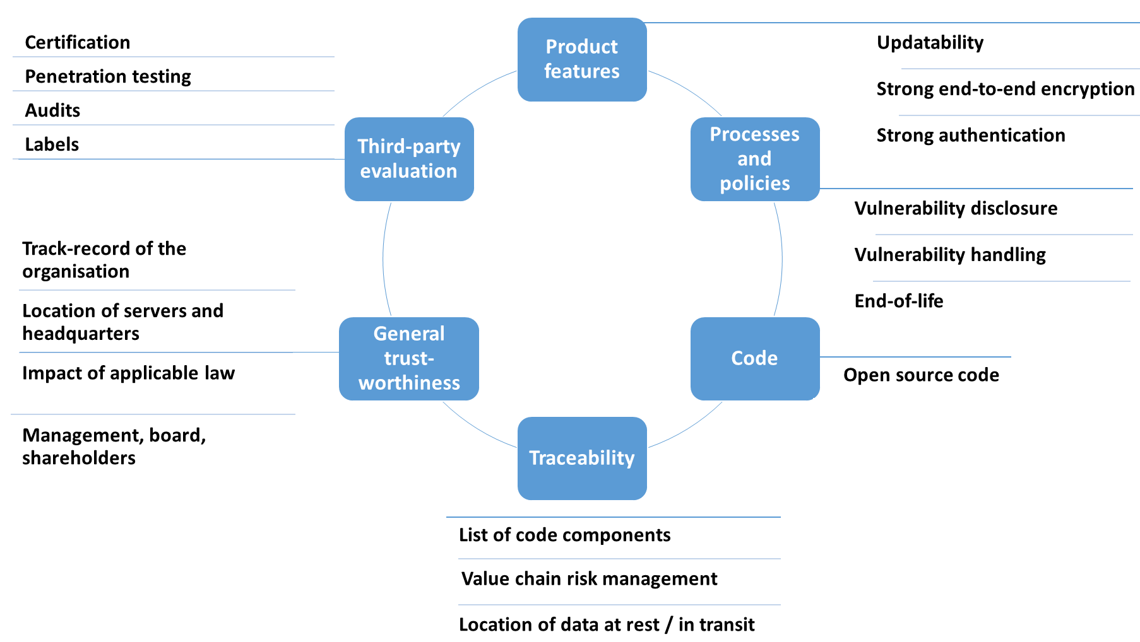
Security by design is a multi-layered concept

Slide 7
Security by design guidelines for IoT are not widely used
  There is strong evidence that IoT products are not designed with enough security:
    In 2016, the Mirai malware infected millions of insufficiently secure IoT devices and enrolled them into botnets to launch massive DDoS attacks.
    In 2018, a study of 331 consumer IoT products in the UK showed that 90% of the manufacturers lack a vulnerability disclosure policy.
    Why? Because most security-by-design guidelines are voluntary, and economic factors / market dynamics limit their adoption by supply-side actors:
    Misaligned market incentives : time-to-market, cost effectiveness are often at odds with security
    Information asymmetries : consumers cannot assess the level of digital security of IoT products
    Externalities: the actors managing digital security risk do not bear the consequences.
    Misperception of risk and misallocation of responsibilities.

Slide 8
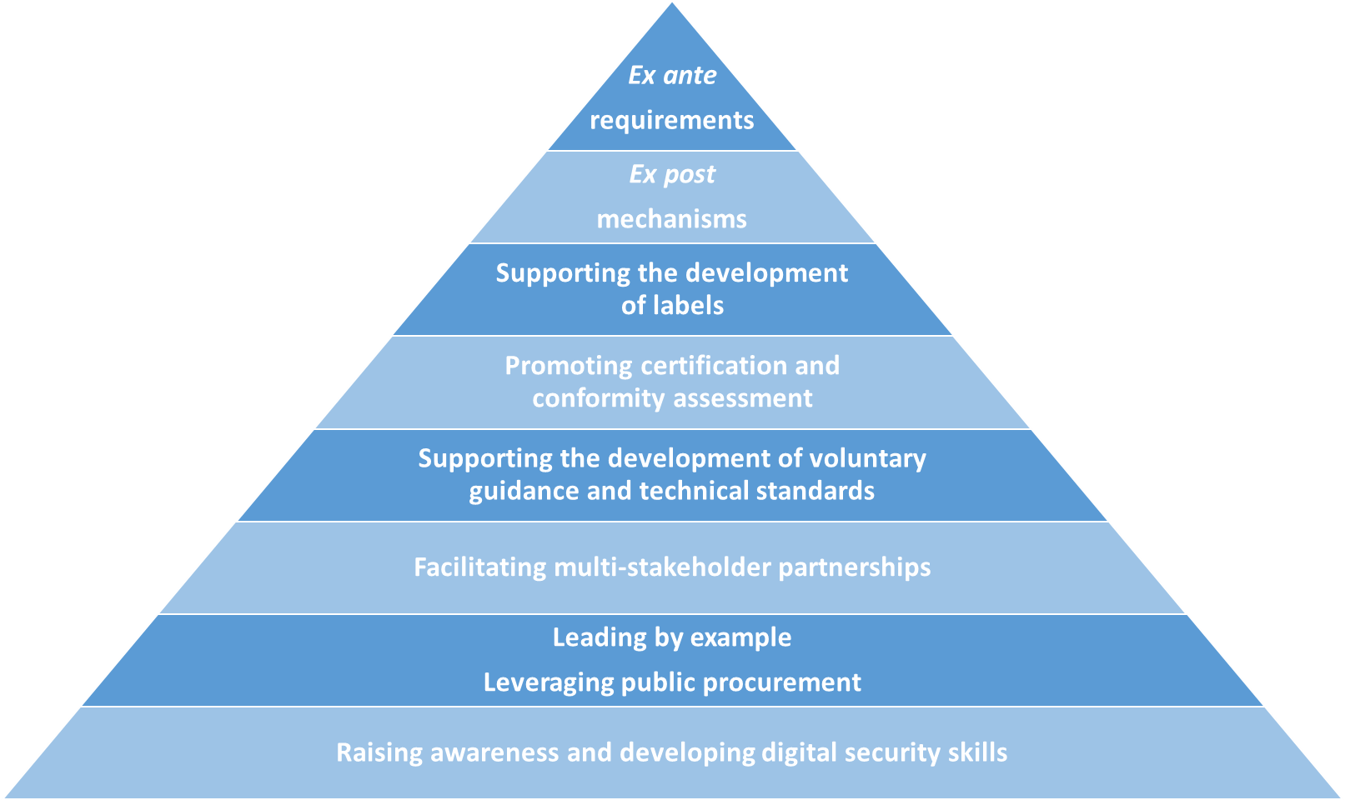
Smart policies for smart products: a policy toolkit
2020-2021: draft regulations discussed in:
EU
Japan
UK
2020-2021: digital security labels launched or considered in:
Finland
Germany
Japan
EU
2020
ETSI’s EN 303 645
NISTIR 8259
Charter of Trust
Principle 3

